Slide 1
The Relationship Between Crime and Temperature in the U.S.
Jay Jung
Lisa Hu
Marc Palomo
April 8, 2019

Slide 2




Agenda
1
2
3
4
Hypothesis & Project Overview
Deep Dive Analysis
Summary & Conclusion
Q&A
Notes:
Talking points:
Lisa - 1 to 4
Jay - 5-8
Everyone talks about their own pie chart.
Marc 12 to 15 pie comparison in different cities and the chi^2
Everyone talks about their own line and bar graph 16-18
Lisa - comparison for the bar and line comparison 19 and transition to other questions slide 20 - “all things considered…”
Jay - 20
Marc - 21

Slide 3

Hypothesis: If a city’s temperature fluctuates throughout the year, then there is more variance for crimes committed from season to season.

Slide 4
Project Overview
Determine whether crime is affected by temperature
Explored 3 cities that are geographically dispersed with contrasting temperature
Utilized two data sets:
2018 temperature data from Google & Crime Data from Data.gov
Organized, processed, and analyzed data using Python Jupyter Notebook and various libraries (Pandas, Matplotlib, etc) to create graphs
Leveraged Google Maps API to create heatmaps for visualization
Source: Italicized Text (6 point)
Notes:
the focal point is to detemine is there is a direct correlation between temp and crime. we wanted to use weather data but it required an investment and we were feeling kinda cheap so opted out of that. looked into 3 cities that are geographically dispersed with contrasting temperatures - would give us more perspective and draw clearer results. Los Angeles on the west coast with consistent weather throughout the year. Austin in the south that also has more consistent warmer weather. in contrast, NY on the east coast with varying temperature changes throughout the year with more noticeable seasonal changes. After consulting with Chris, he suggested using tempture data from Google, so we obtained the avg highs and lows for each month in 2018.

Slide 5
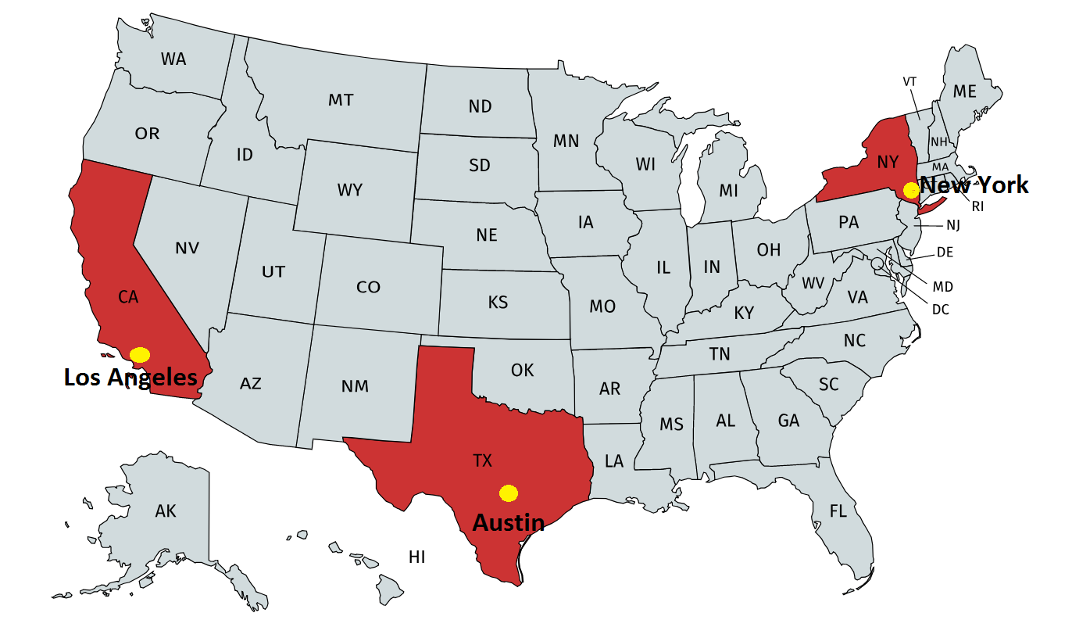
The 3 Chosen Cities

Slide 6
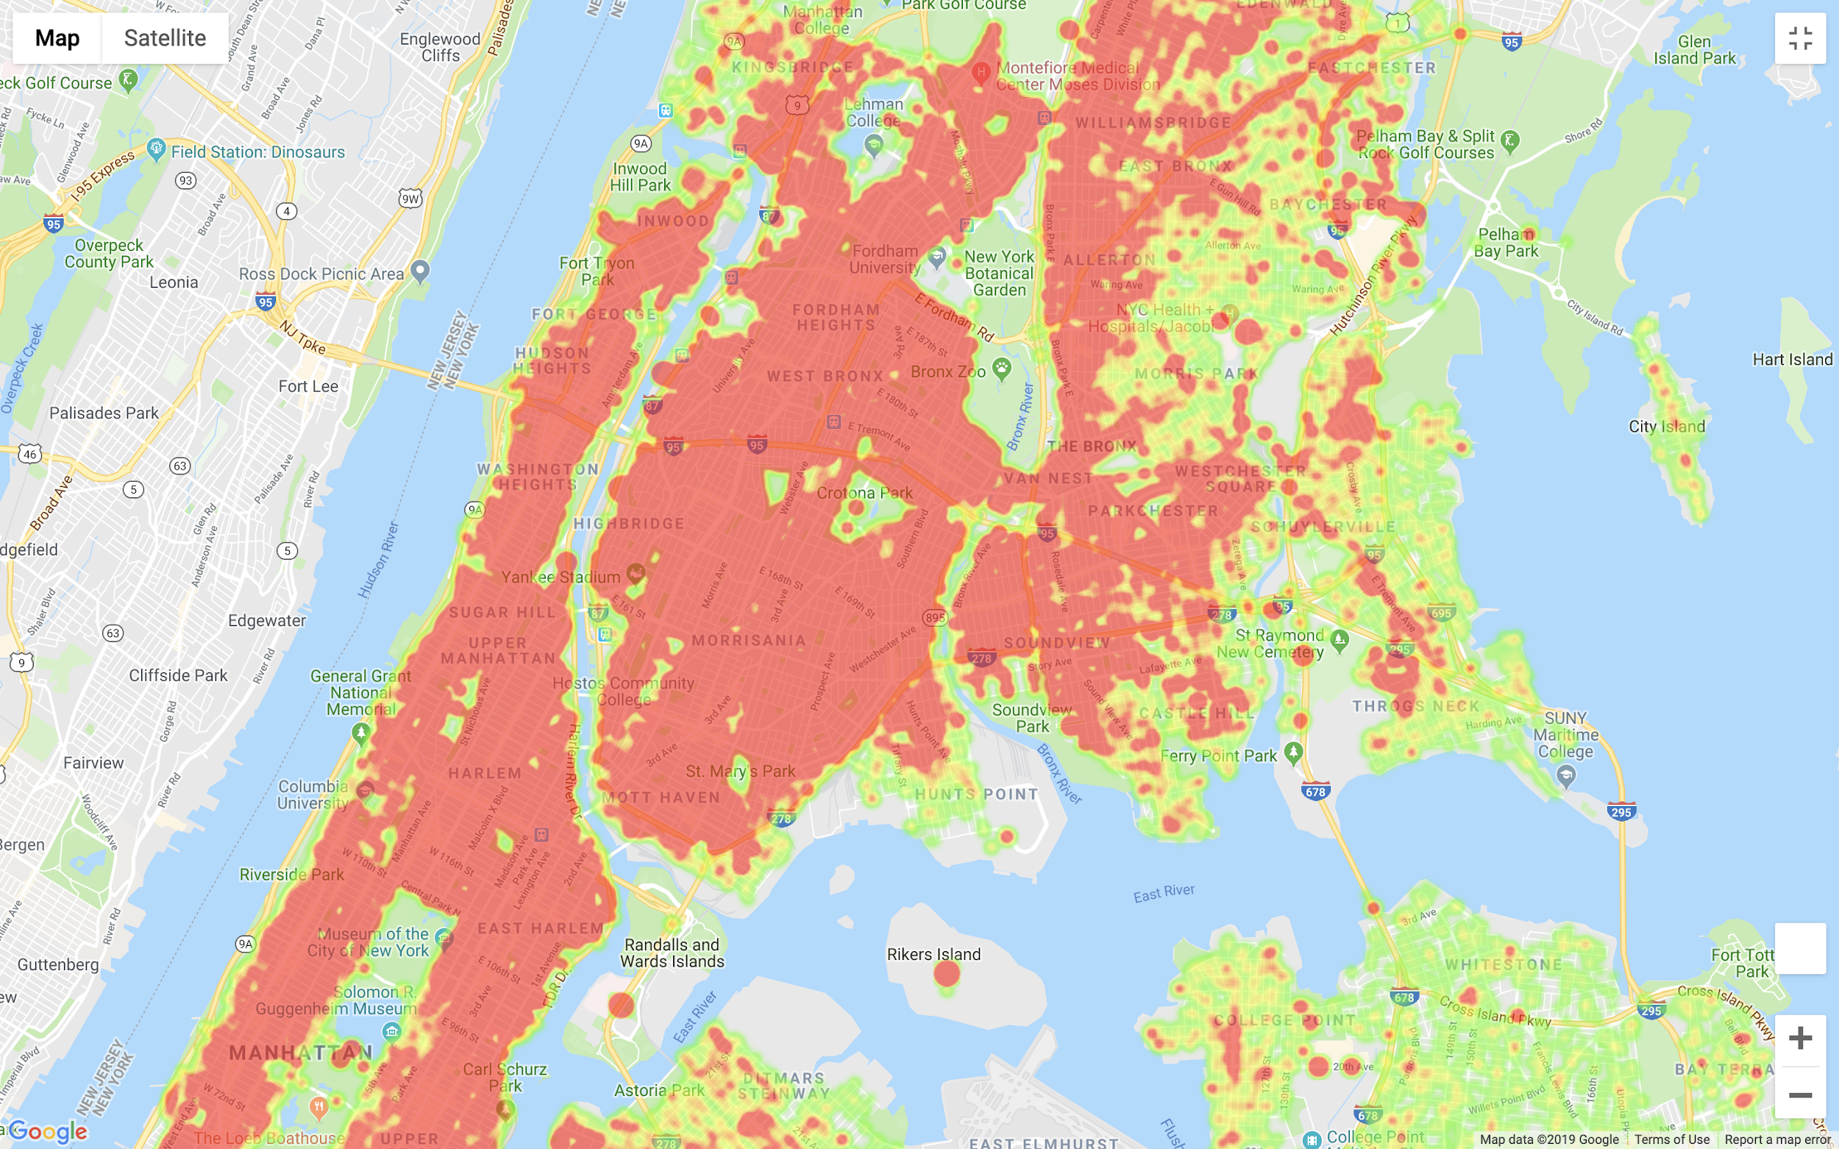
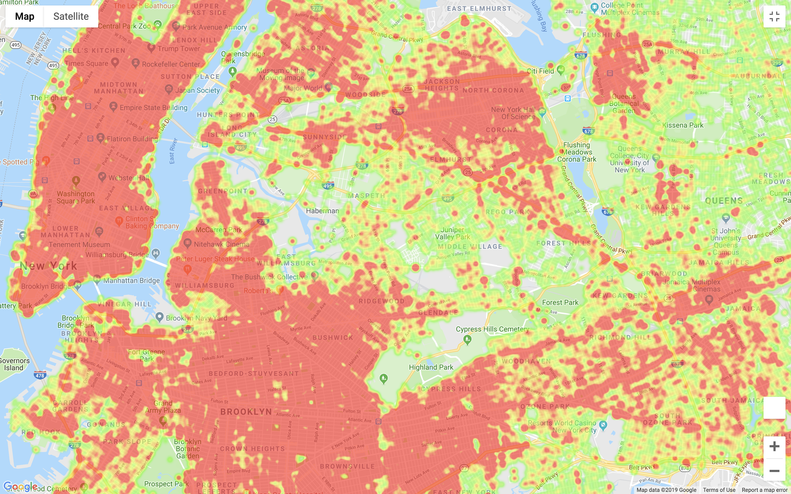
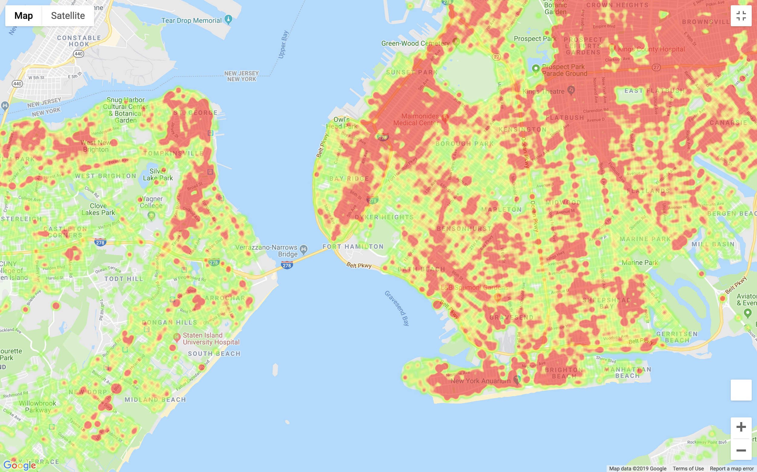
Crimes Committed in New York in 2018
Notes:
used latitude and longitude data to create the heatmaps for each city

Slide 7
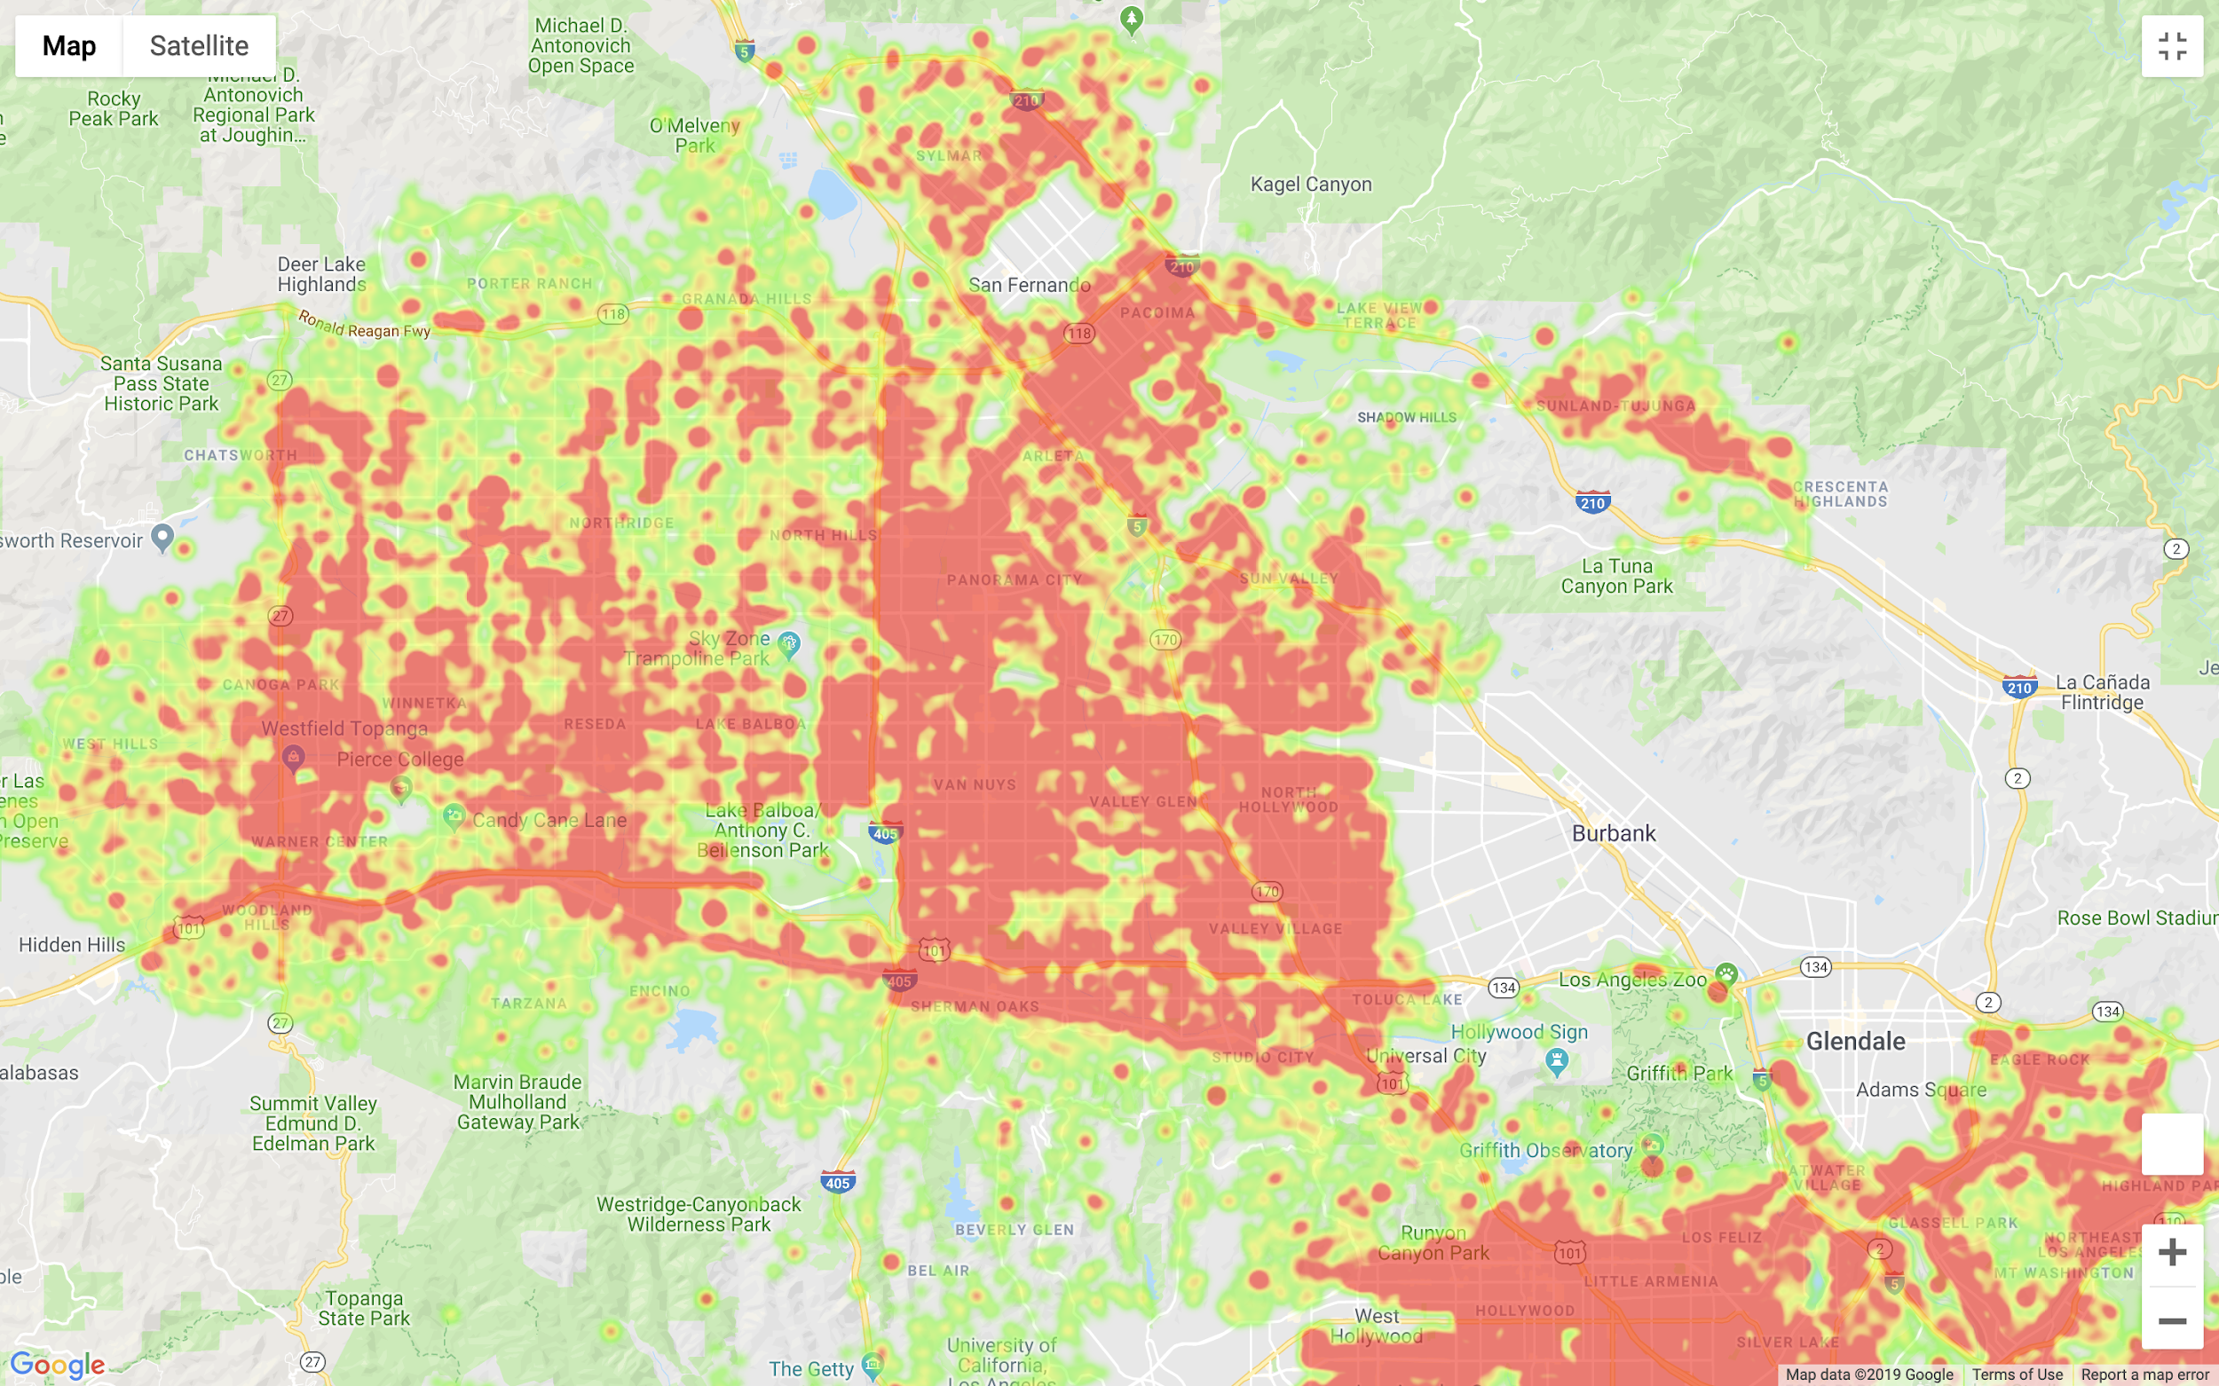
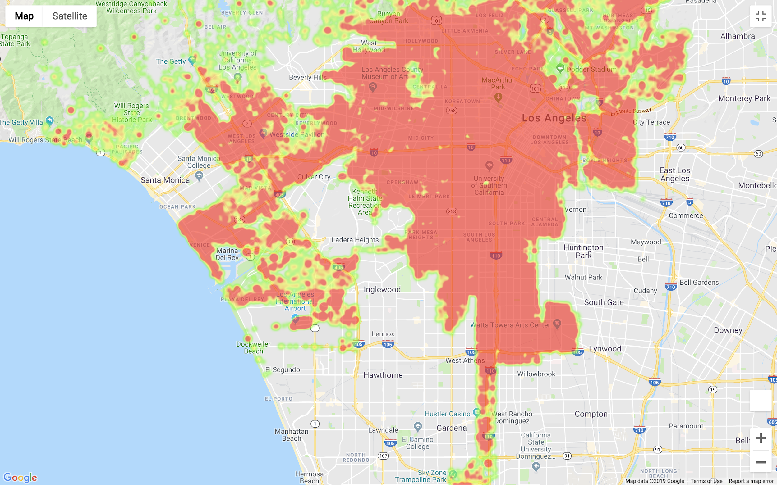
Crimes Committed in Los Angeles in 2018
Notes:
we used latitude and longitude information to create the heatmap for los angeles. when zoomed in, we can identify the dispersion of crimes committed across the neighborhoods

Slide 8
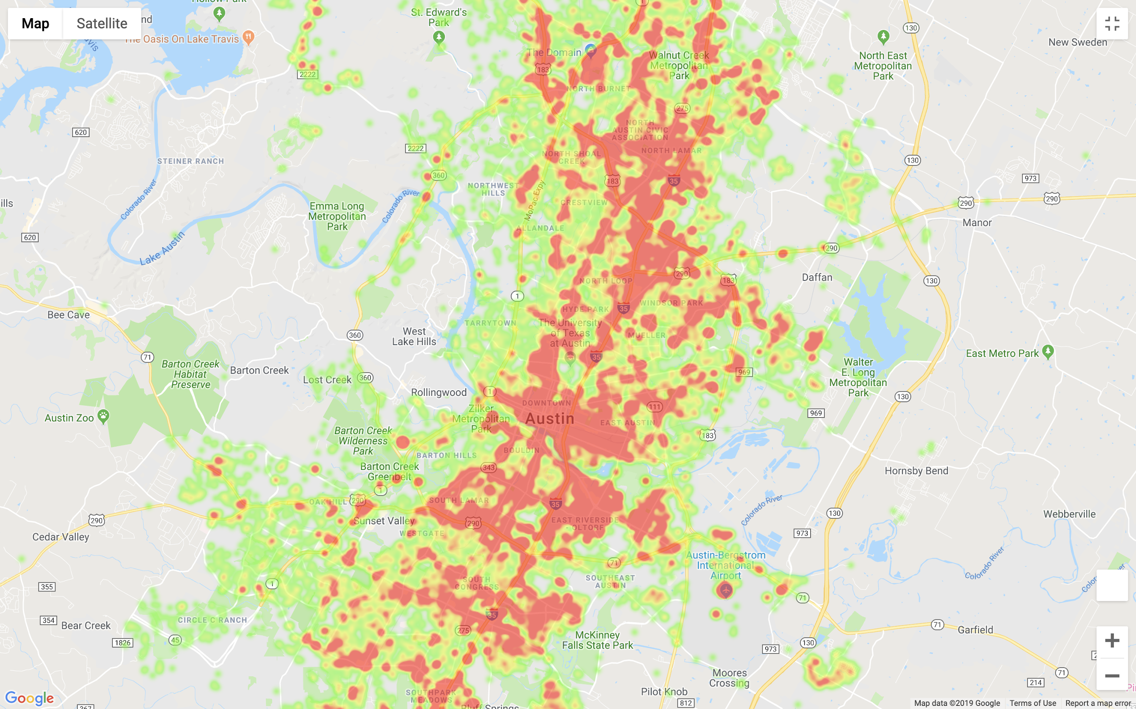
Crimes Committed in Austin in 2018

Slide 9
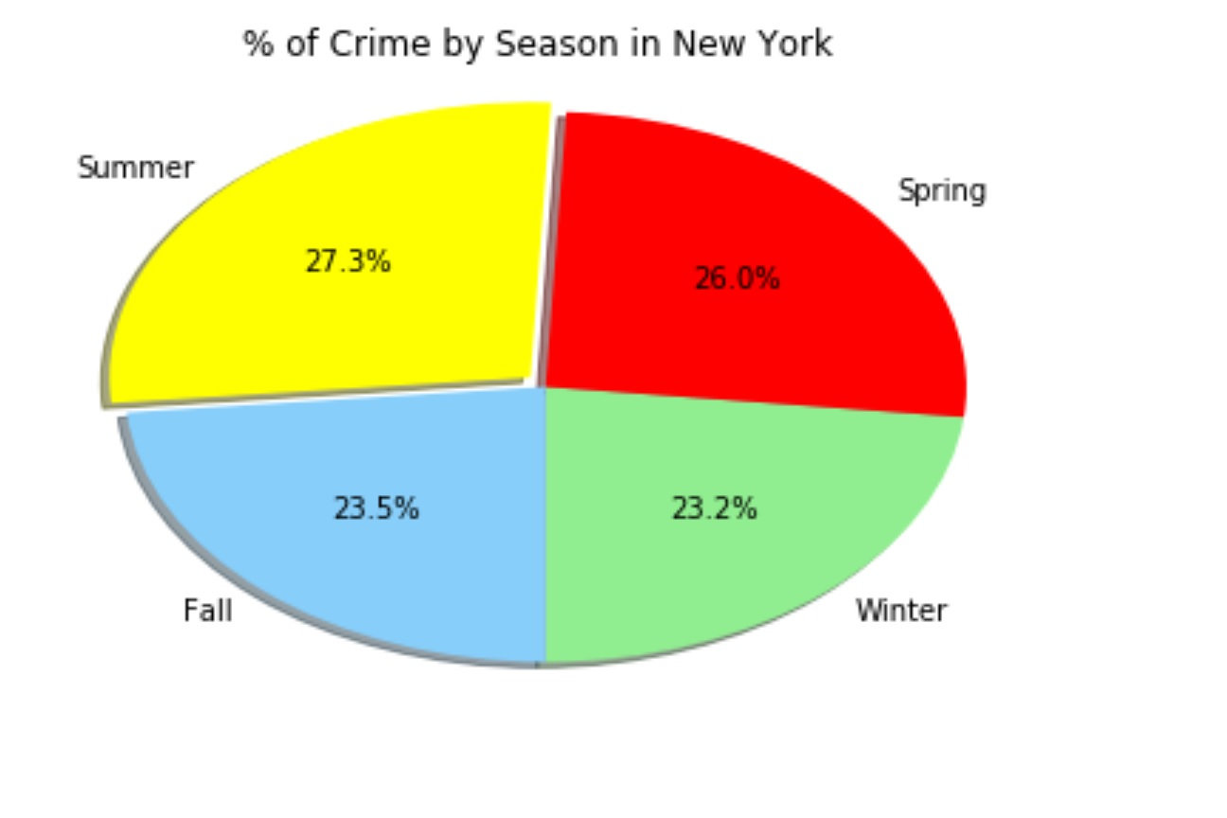
Higher Crime Rates in Spring and Summer in New York
Excluding population and size from the equation, the cities can be compared to one another based on percentage breakdown of crimes by season

Slide 10
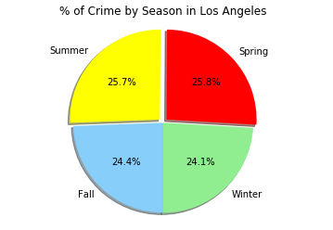
Relatively Consistent Crime Rates Throughout The Year with Slight Increase in Spring and Summer in Los Angeles
Notes:
Looking at the percentages the seasons are very similar; variance for crimes committed by percentage is very subtle. however, looking at the crimes committed instances across seasons the numbers are more noticeable. With a difference of 3k to 4k between seasons.
Winter: 54474
Spring: 58342
Summer: 58052
Fall: 55194

Slide 11
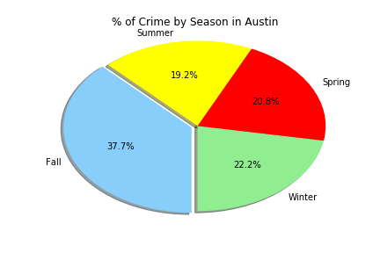
Crime Rate is Relatively Similar Across 3 Seasons With a Huge Spike Observed in Fall Season in Austin

Slide 12
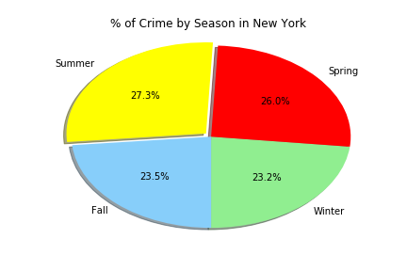
Population Varied Across The Cities, So We Analyzed Each Individually
NYC Crimes Committed: 452,997
LA Crimes Committed: 226,062
Austin Crimes Committed: 48,442

Slide 13
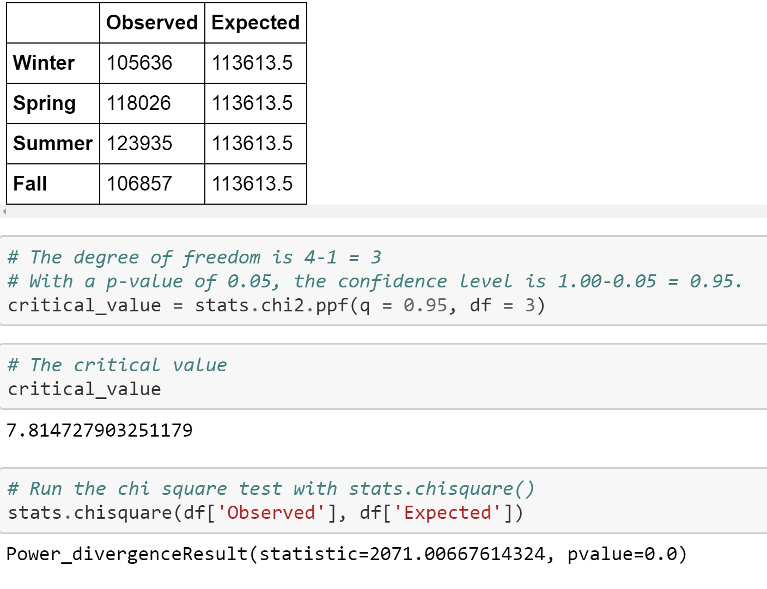
New York Chi-Squared Result
* If temperature fluctuation has no effect on crime, then there should not be a variance for crimes committed season to season
Notes:
If temperature fluctuation has no effect on crime, then there should not be a variance for crimes committed season to season. Also, because pvalue is 0, we can reject null

Slide 14
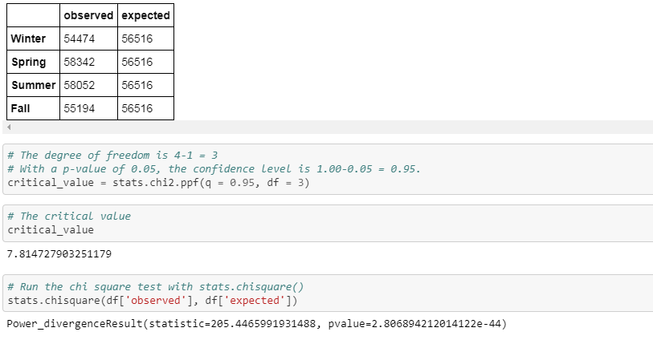
Los Angeles Chi-Squared Result

Slide 15
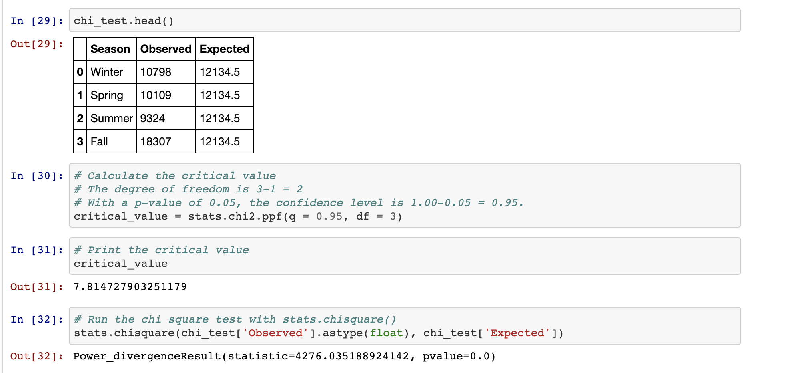
Austin Chi-Squared Result
Notes:
If temperature fluctuation has no effect on crime, then there should not be a variance for crimes committed season to season.

Slide 16
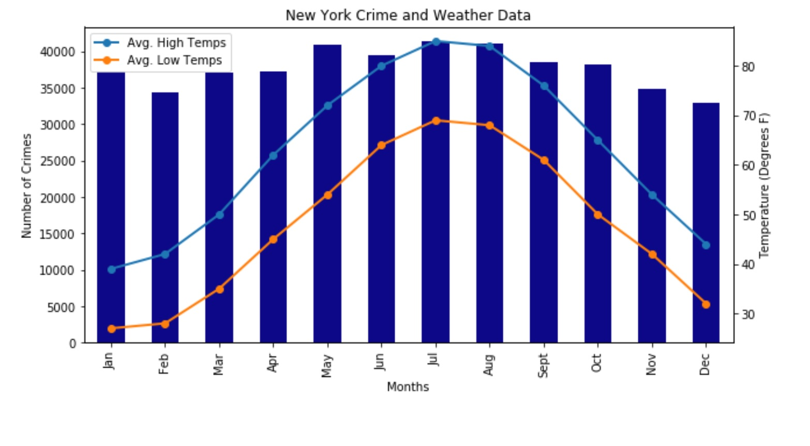
New York Illustrates a Rollercoaster Relationship Between Temperature and Crime
Notes:
Demonstrates crimes committed by season
Illustrates temperature variance throughout the year by season
Prove that since NY has stronger temperature variance, there should be a more noticeable difference for the # of crimes committed in each season

Slide 17
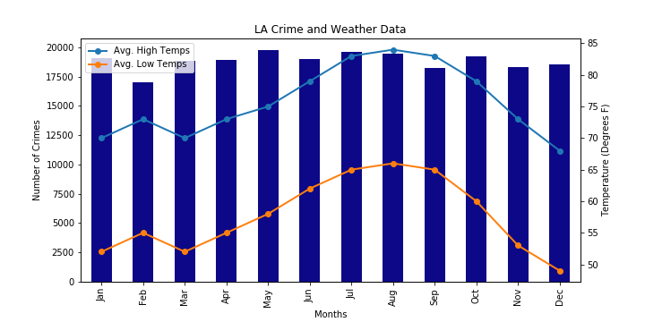
Los Angeles Demonstrates Incongruent Relationship Between Temperate and Crime; However, a “Sweet Spot” in Temperature Could Trigger More Crime
Notes:
March has higher crime than feb but there is a dip in tempature. This is inconsistent with our expectation that in this case crime shouldve dipped since temp decreased. Looking at this closer….There are spikes for crime in May and Oct where temperature is more moderate compared to the colder months or hotter months. Therefore are sweet spot in temperature could yield more crimes committed

Slide 18
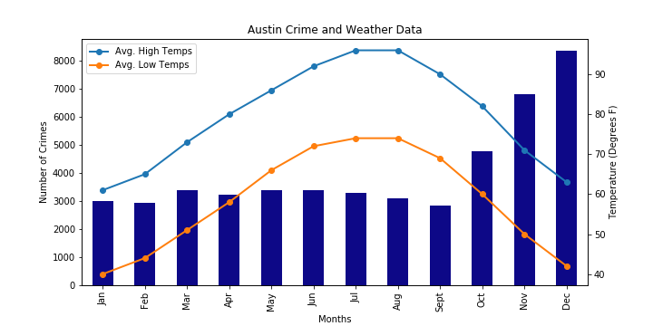
Austin’s Substantial Increase in Crime in The Last Three Months of the Year Suggests Moderate Temperature and The Holidays as Potential Influences
Notes:
Demonstrates crimes committed by season
Illustrates temperature variance throughout the year by season
Prove that since NY has stronger temperature variance, there should be a more noticeable difference for the # of crimes committed in each season

Slide 19
The Three Cities Indicate Incongruent Trends Suggesting Factors Other Than Temperature That Affects Crime Rate
Notes:
Temperature is one cause for crime to increase or decrease, but the results indicate other causes such as ….events that may have happened, Daypart, specific crimes that are affected by temperature but not all crimes are affected..refering online articles, for instance, robbery is influecned by temperature whereas homicide isnt. The type of crime matters but was not part of our focus for this project

Slide 20
Other Questions to Consider…
LA data contains all types of crimes and time stamp
None of the other data sets contained type of crime or time stamp
What are other factors besides weather that influence crime?
Variance based on busyness:
# of visitors
Other events
Variance based on specific neighborhood contexts:
Stores
Bars
Universities
Variance based on city specific initiatives targeting crime
Time of occurrence (daypart)
Weather on specific days and at specific times
Historical vs. 2018 only

Slide 21
Summary and Conclusion
We can reject the null hypothesis since the p-value for all 3 cities is smaller than 0.05
There is a relationship in the variance of crime by season (relative temperature) so we can conclude the cause is not due to chance
The analysis suggests that a relationship between crimes committed and weather exists; however, more analysis would be needed to determine the extent that weather, or temperature, impacts the crimes committed in our 3 cities

Slide 22
QUESTIONS

Slide 23
Appendix

Slide 24
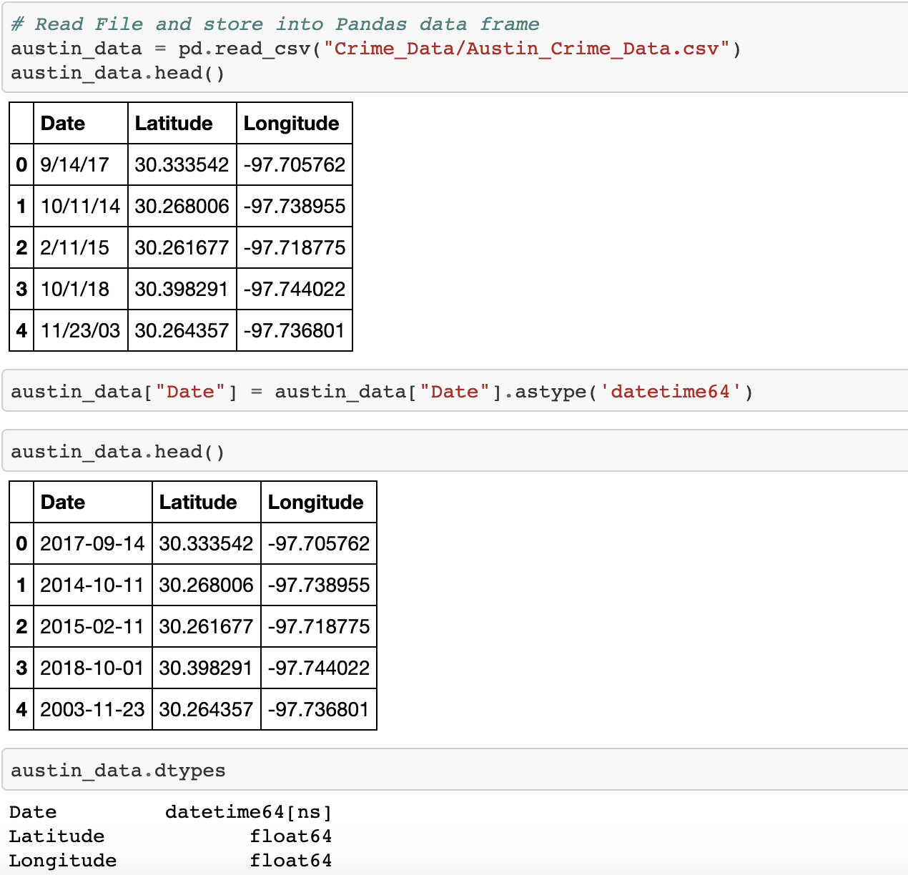
Converting to Datetime Code

Slide 25
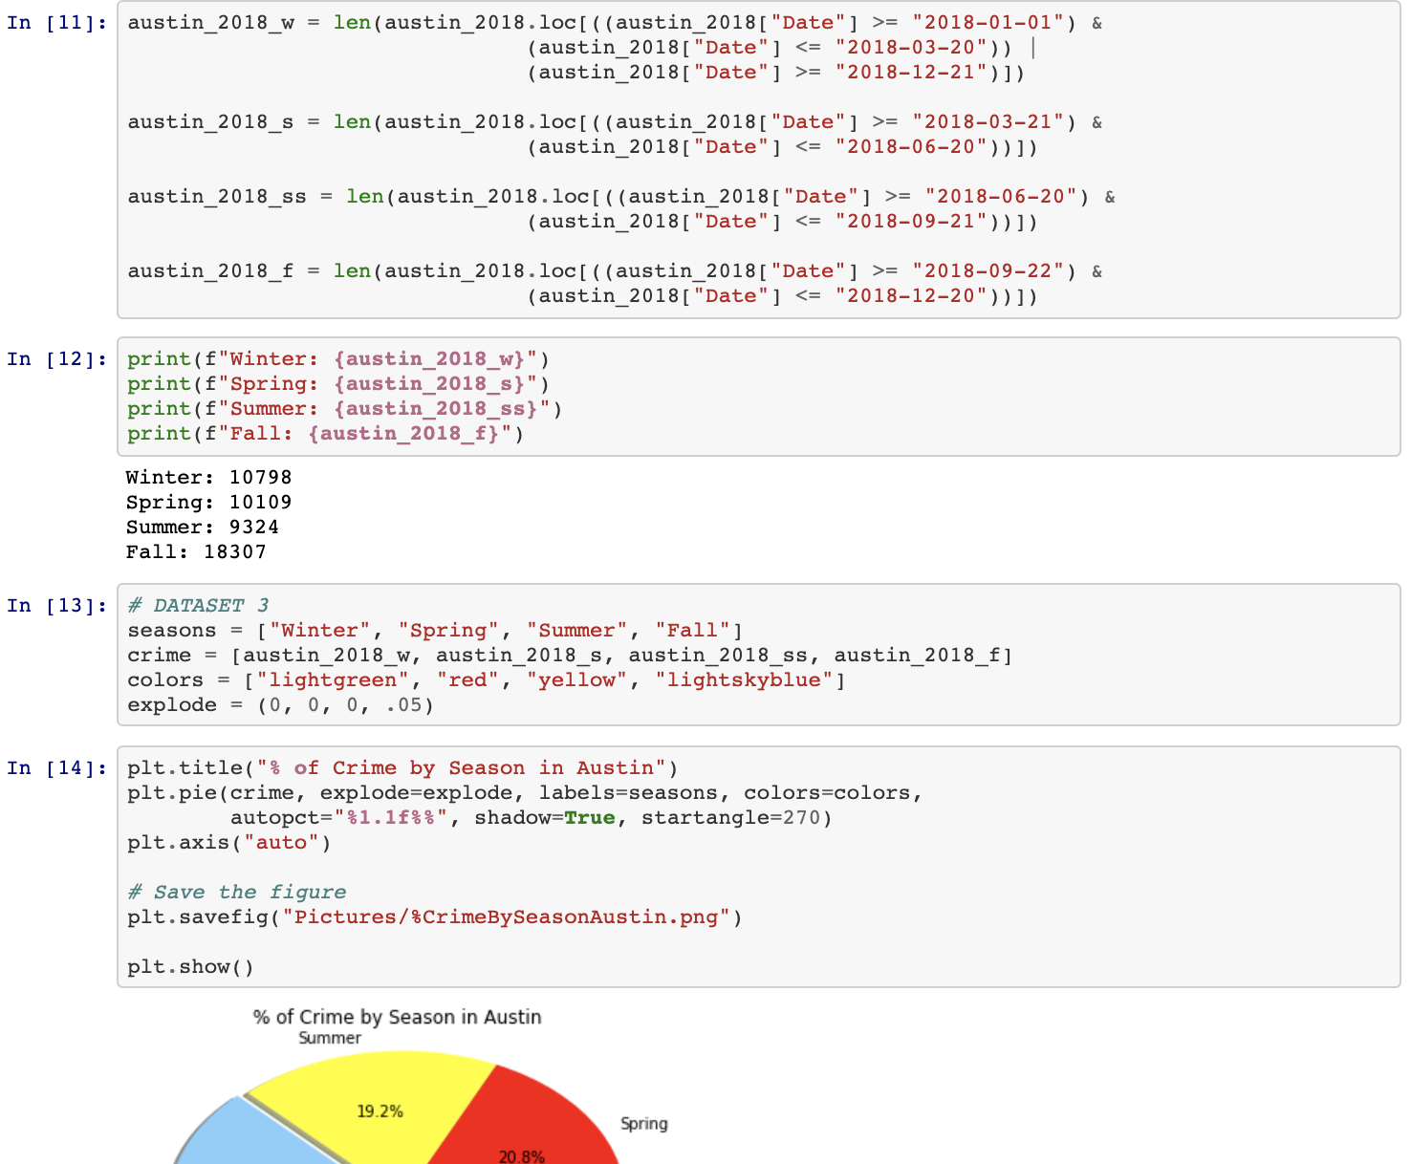
Pie Chart Code

Slide 26
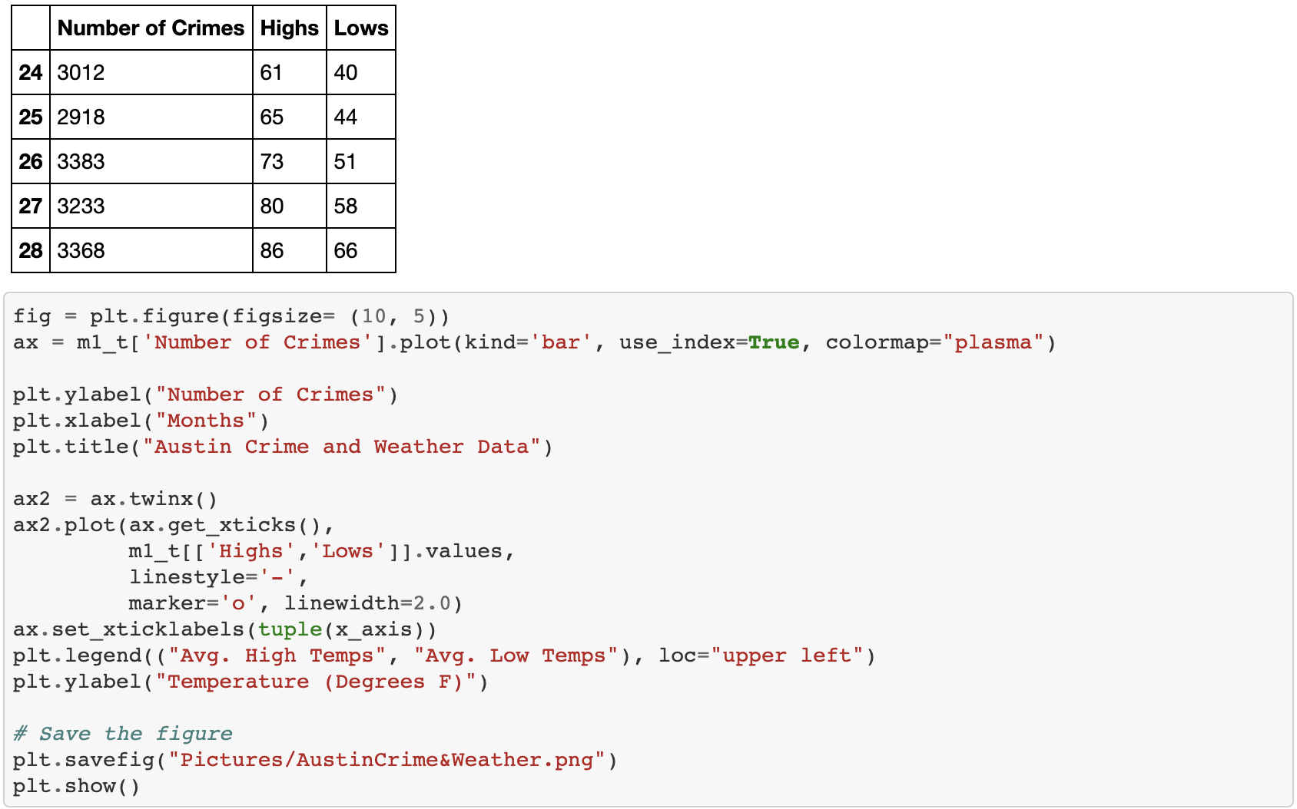
Bar & Line Graph Code

Slide 27
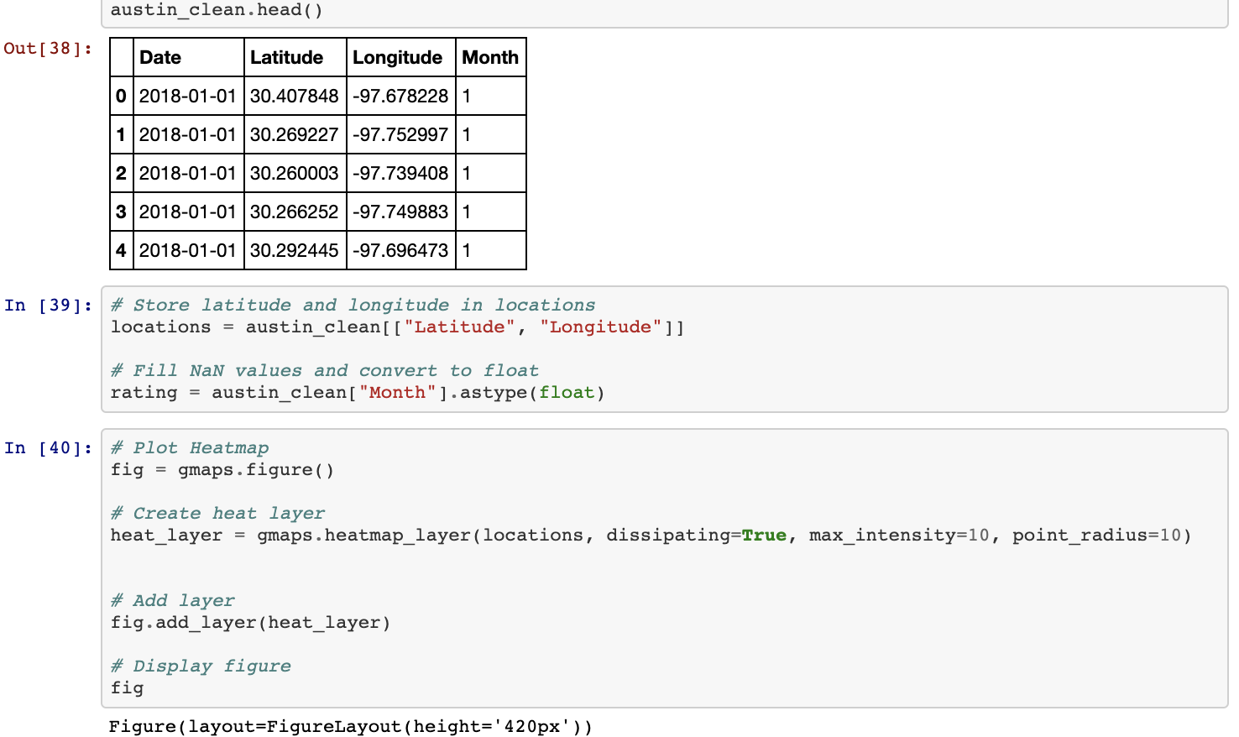
Heatmap Code

Slide 28
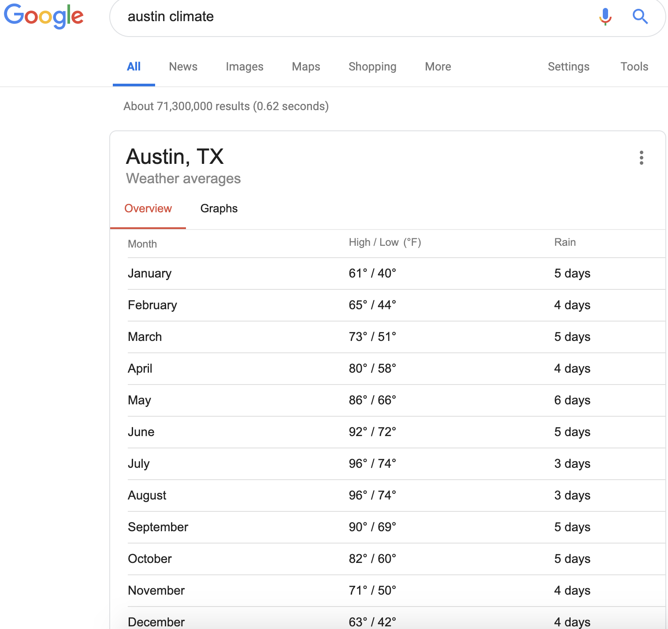
Sources Used for Assignment
Crime Data: https://catalog.data.gov/dataset/crime-data-from-2010
Weather Data: Google “<city> climate”

Slide 29
Notes:
Co-branded closing slide example

